Slide 1

COMPARATIVE STUDY ON FAKE NEWS ACCURACY PREDICTION USING NAÏVE BAYES, SVM AND ANN
BATCH – 11
Guided by
Assistant Professor
MRS.K.SUNEETHA
Balaga Susmitha
(16JG1A0515)
Dasari Poornima
(16JG1A0524)
Ayyalasomayajula Akshata (16JG1A0511)
Koppala Likhita
(16JG1A0560)
Department of Computer Science and Engineering
GAYATRI VIDYA PARISHAD COLLEGE OF ENGINEERING FOR WOMEN

Slide 2
CONTENTS
Abstract
Introduction
Existing System
Proposed System
System Requirements
Project Modules
UML Diagrams
Algorithms
Conclusion
Future Enhancement
References

Slide 3
ABSTRACT
Fake news is one of the biggest banes in our digitally connected world. Fake news spreads like wildfire and is impacting millions of people everyday .With the advancement of digitized society, information is free for everyone and it can be manipulated by anyone. This lead to the enlargement in the spread of fake news and misinformation leading to many problems. In order to filter the information and to verify the trustworthiness of a news, we need a freely available tool. Our dataset is initially preprocessed and then it is tested using Machine Learning algorithms such as Naïve Bayes, SVM and ANN to predict the accuracy and compare them.

Slide 4
INTRODUCTION
The objective of this project is to use algorithms like Naïve Baye’s, Support Vector Machine and Artificial Neural Networks and accuracy is obtained.
It also provides a comparative study on fake news prediction model based on the algorithms used .
The dataset used is a corpus of words/vocabulary that is created based various news articles.

Slide 5
EXISTING SYSTEM
BS Detector is a plug-in used by Mozilla and Chrome browsers to detect the presence of fake news sources and to alert the user accordingly.
It states a warning message if the article is found to be fake
It does not specify the percentage of error and neither does it classify news into levels of “truthfulness” or “fakeness”.
BS Detector

Slide 6
PROPOSED SYSTEM
The project comes up with a proposed work on pre- processing a dataset of both fake and real news and employ a Machine Learning Algorithm or Artificial Neural Network concept in order to create a model that predicts the accuracy based on its words and phrases.
This model helps to find the efficient algorithm that can be used for the Accuracy of fake news.

Slide 7
SYSTEM REQUIREMENTS
Hardware:
Processor: i3 or above
RAM:4.00GB (3.90 GB usable)
System Type: 64-bit OS
Software :
Python - version 3.7
Anaconda - version 3.5.01

Slide 8
PROJECT MODULES
Data Preprocessing
Training The Model
Accuracy Prediction

Slide 9
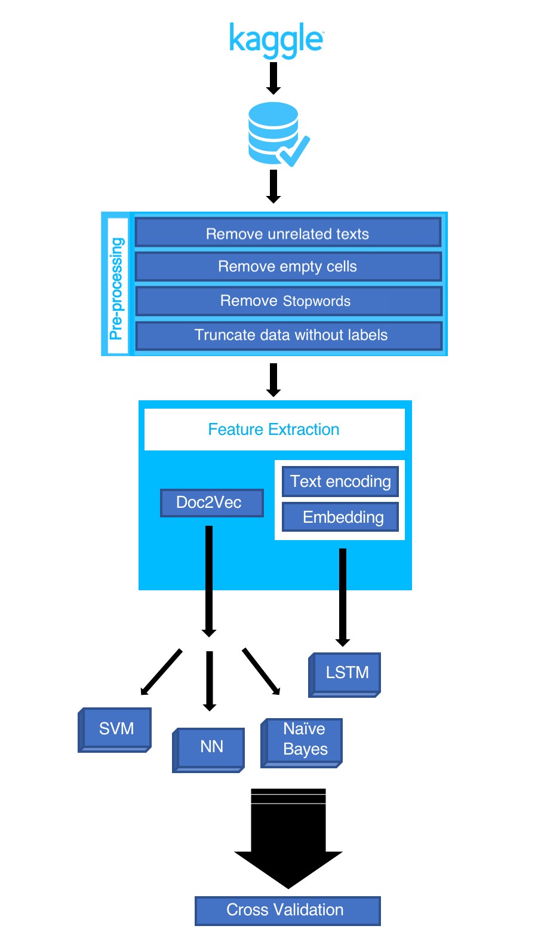
Workflow
Training the Model
D0C2VEC
Naive Bayes
SVM
ANN
Accuracy As Output

Slide 10
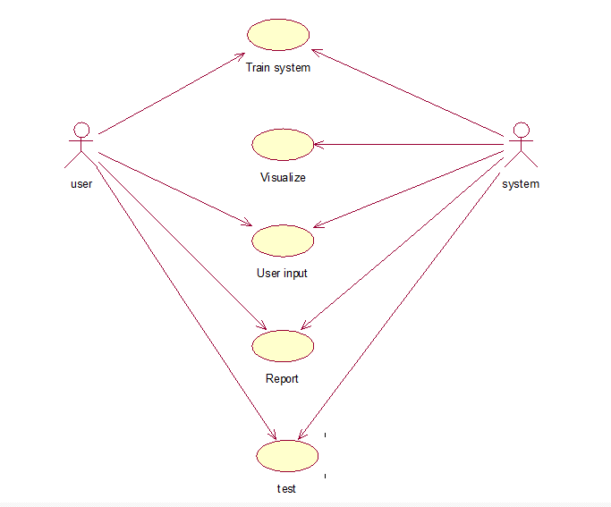
SYSTEM DESIGN (UML DIAGRAMS)
USE CASE DIAGRAM:

Slide 11
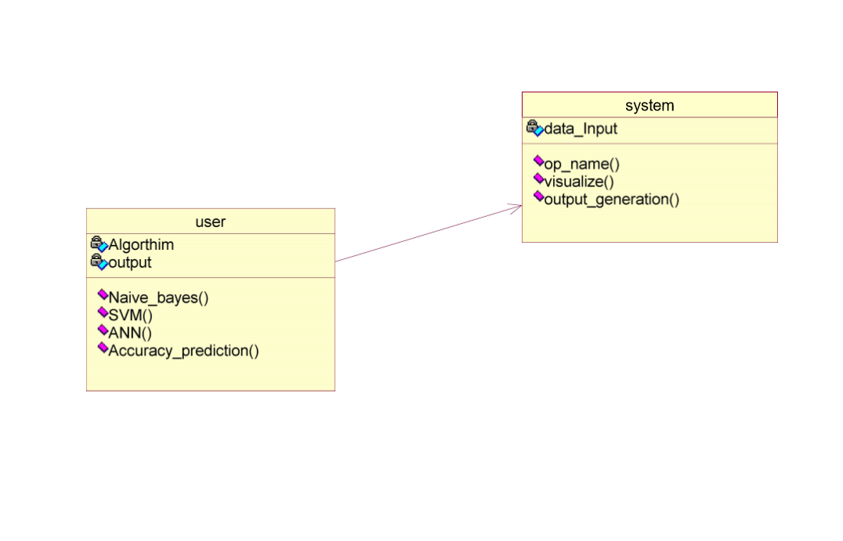
Class Diagram :

Slide 12
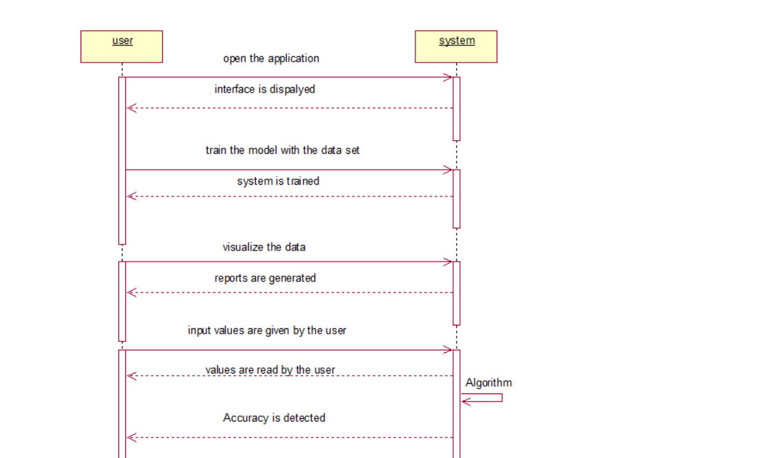
Sequence Diagram :

Slide 13
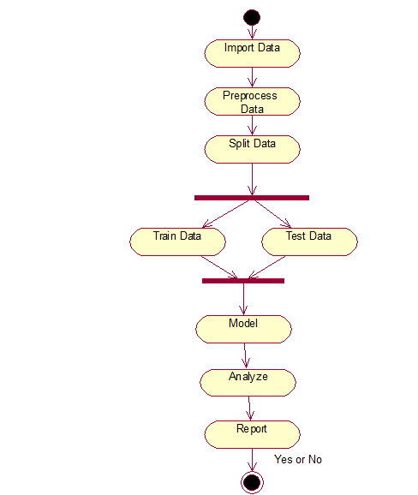
Activity Diagram :

Slide 14
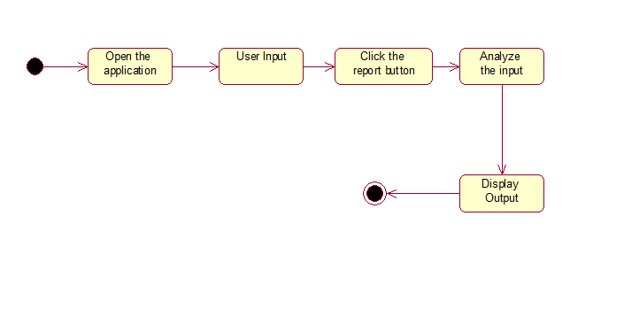
State Chart Diagram :

Slide 15
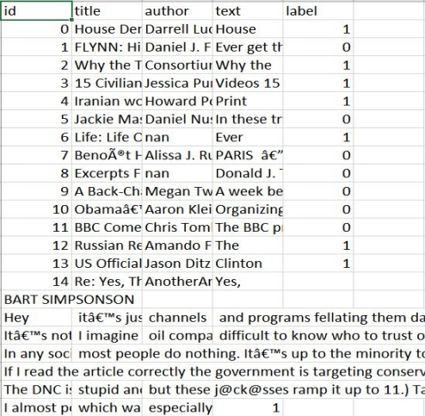
Data
Dataset Source - Kaggle
Attributes - ID,Title,Author,Text,Label
Label 1 - Unreliable
Label 0 - Reliable

Slide 16
Data Preprocessing
Perform various text cleaning steps
1.Remove all non-alphanumeric characters
2.Delete stopwords
3.Delete MissingRows

Slide 17
Doc2Vec Model
Based on Word2Vec model
Extracts Word2Vec features and adds an additional “document Vector” with information about the entire document.

Slide 18
Training a Model
Models used :
- Naive Bayes
- Support Vector Machine
- Artificial Neural Network

Slide 19
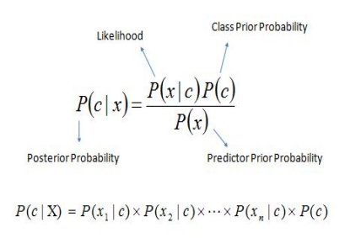
NAÏVE BAYES
Based on Bayes theorem
Naïve comes from the assumption that the features in the dataset are independent
Best suitable for text based classification
The posterior probability of each class can be calculated by using the formula

Slide 20
SUPPORT VECTOR MACHINE
SVM is a supervised machine learning algorithm that can be used for both classification and regression.
Its objective is to find a hyperplane in an N-dimensional space(N means the number of features) that distinctly classifies the data points.
Highly preferred as it produces significant accuracy with less computation power

Slide 21
NEURAL NETWORKS
Neural Networks is a series of algorithms that helps in understanding the underlying relationships in a set of data through a process that mimics the way the human brain operates.
Once the neural network has been trained on samples of data, it can make predictions by detecting similar patterns in future data.

Slide 22
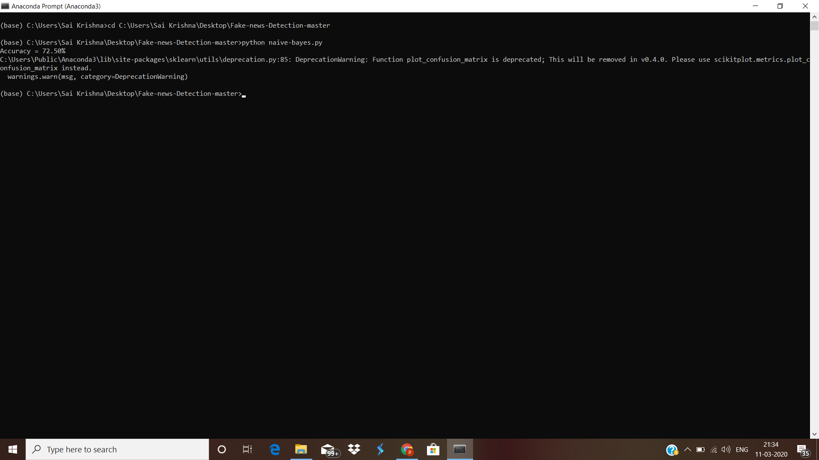

Output Screens :
Accuracy using Naïve Baye’s Algorithm :
Accuracy using Support Vector Machine :

Slide 23
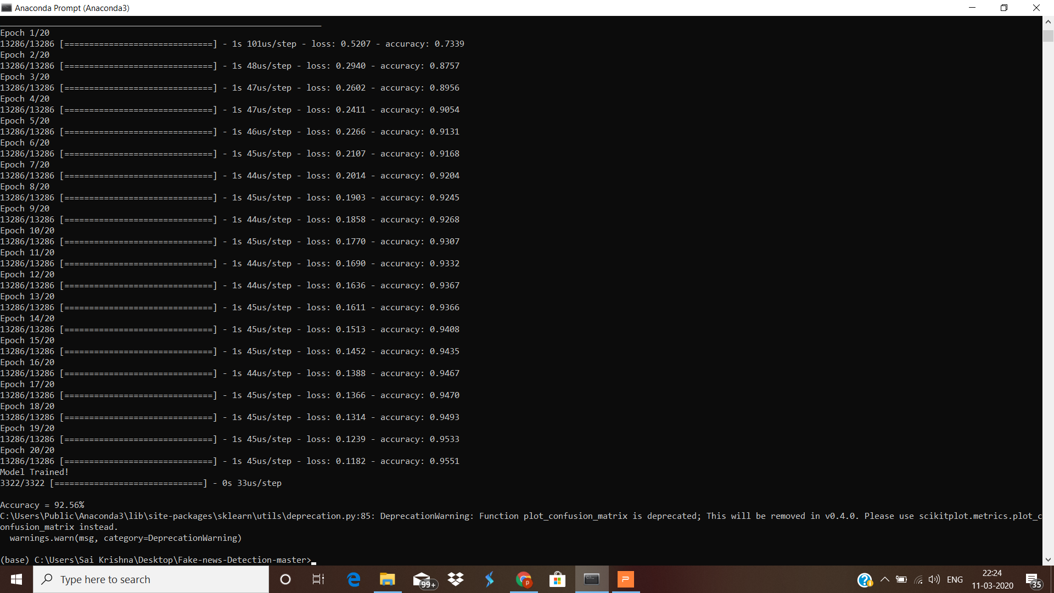
Accuracy using Artifical Neural Networks :

Slide 24
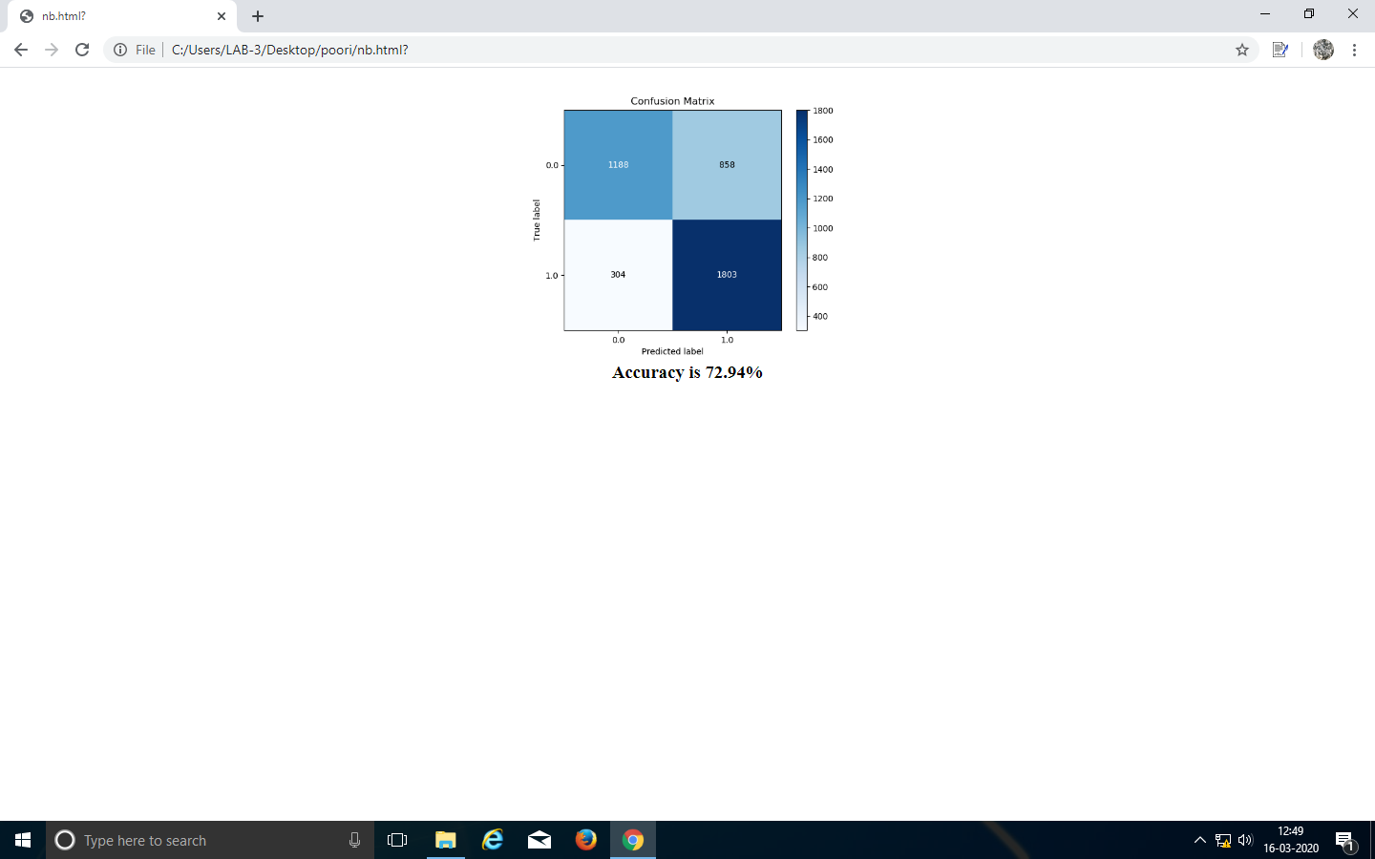
Naive Bayes Result

Slide 25
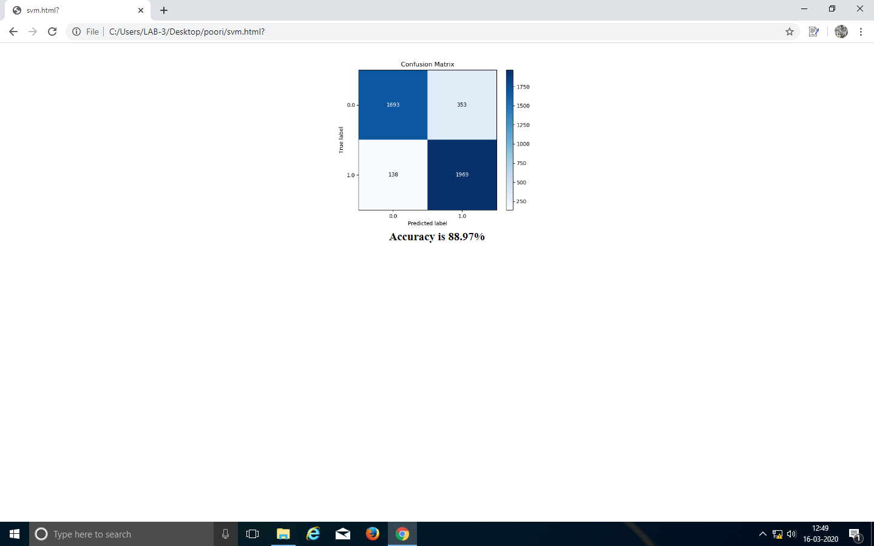
SVM Result

Slide 26
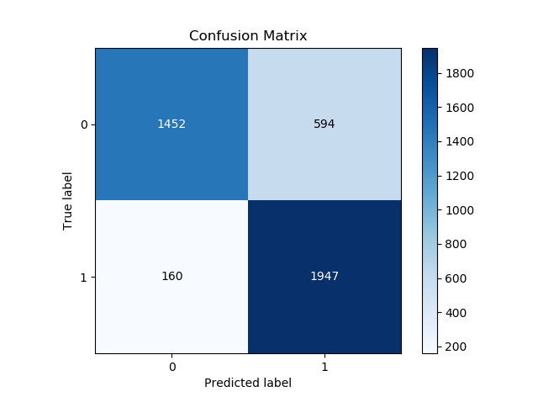
ANN Result
Accuracy is 92.97%

Slide 27
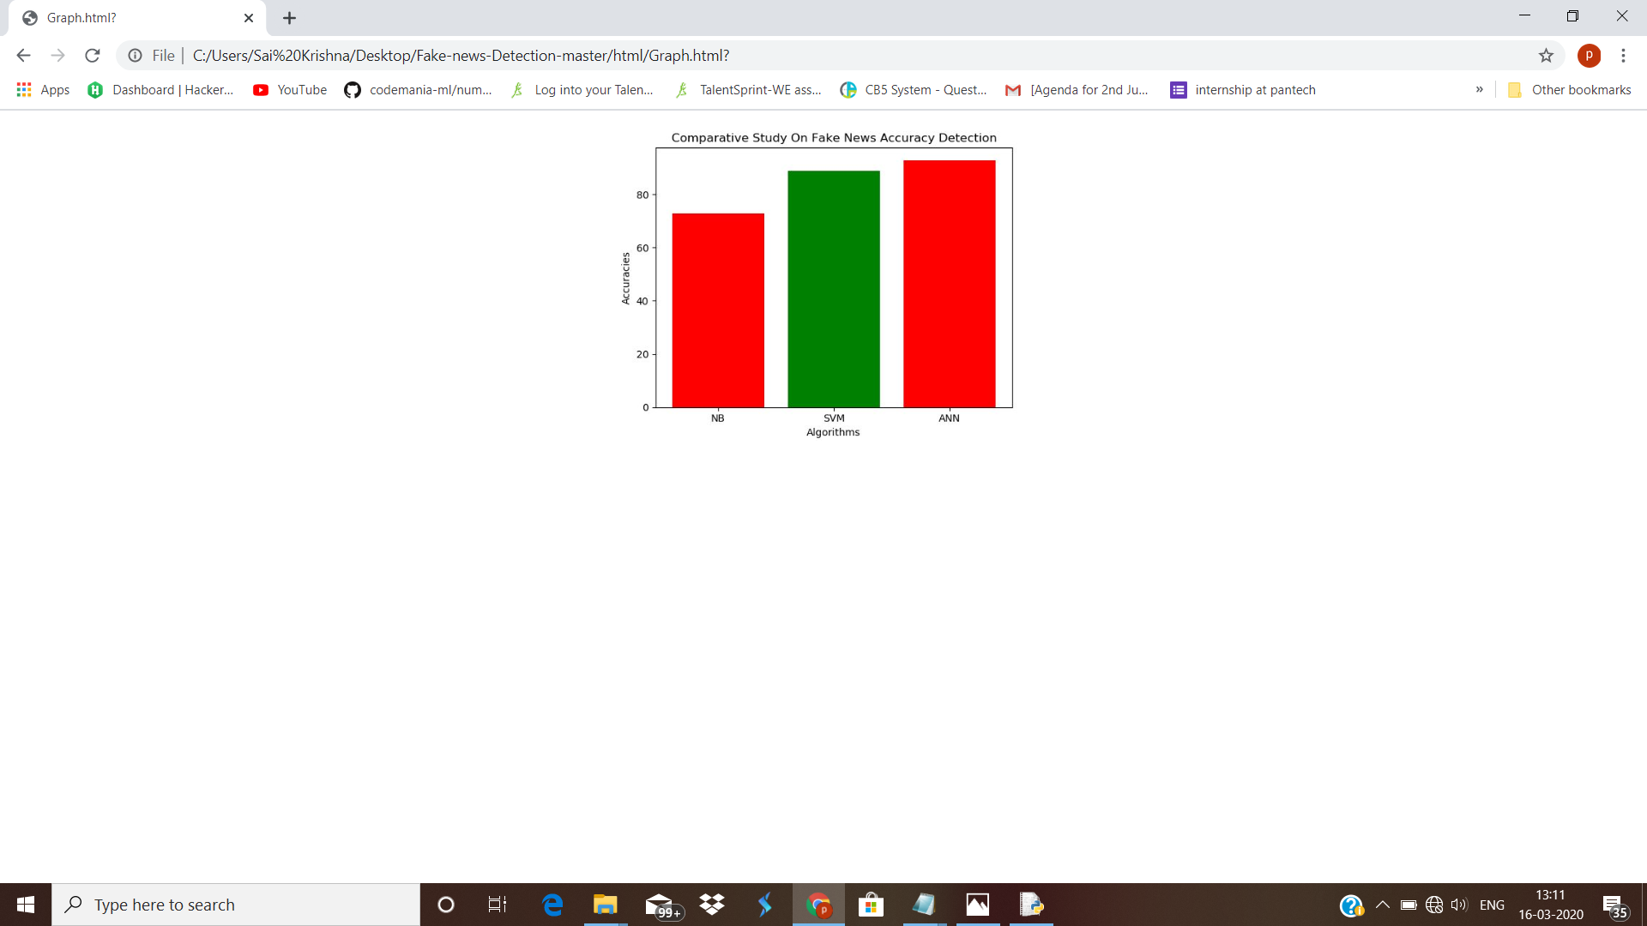
Comparative Study On Fake News Accuracy Prediction
Accuracy Plot :

Slide 28
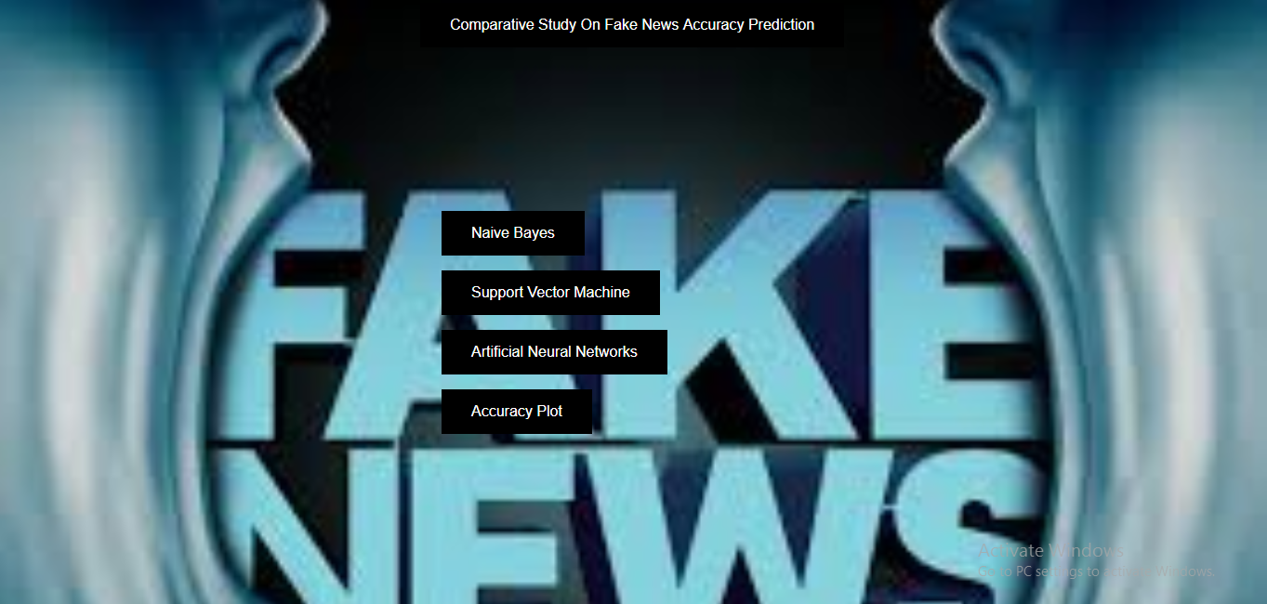
Front Page

Slide 29
CONCLUSION
Combination of machine learning and artificial neural networks are useful for fake news accuracy prediction.we build a model for fake news accuracy prediction using machine learning algorithms.
For text processing, we applied Naive Baye’s Algorithm, SVM and ANN. Artificial Neural Networks gives the best accuracy out of all.

Slide 30
FUTURE ENHANCEMENTS
This project can be updated in near future as it is very flexible in terms of expansion data i.e., it can be used for larger dataset .
If at all we are given any live streaming data then we can detect whether the news is fake or real.

Slide 31
REFERENCES
[1] Conroy, Niall & Rubin, Victoria & Chen, Yimin. (2015). Automatic Deception Detection: Methods for Finding Fake News. . USA
[2] Ball, L. & Elworthy, J. J Market Anal (2014) 2: 187. https://doi.org/10.1057/jma.2014.15
[3] Lu TC. Yu T., Chen SH. (2018) Information Manipulation and Web Credibility. In: Bucciarelli E., Chen SH., Corchado J. (eds) Decision Economics: In the Tradition of Herbert A. Simon's Heritage. DCAI 2017. Advances in Intelligent Systems and Computing, vol 618. Springer, Cham
[4] Rubin, Victoria & Conroy, Niall & Chen, Yimin & Cornwell, Sarah. (2016). Fake News or Truth?Using Satirical Cues to Detect Potentially Misleading News. . 10.18653/v1/W16-0802
[5] www.kaggle.com
[6] https://deeplearning4j.org/keras-supported-features
[7] https://en.wikipedia.org/wiki/Naive_Bayes_classifier
[8] https://ieeexplore.ieee.org/document/7489220
[9] https://www.kaggle.com/rksriram312/fake-news-nlp-stuff/notebook
[10] https://ieeexplore.ieee.org/document/8546944
[11] https://ieeexplore.ieee.org/document/8862770
[12] https://towardsdatascience.com/support-vector-machine-introduction-to-machine-learning-algorithms-934a444fca47

Slide 32

ANY QUERIES

Slide 33
THANK YOU

